Slide 1
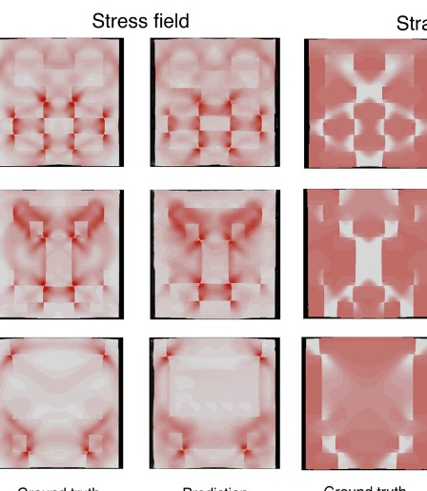


Image Classification and Digital Image Correlation
AFRL Scholars Program
6/12 – 6/23 , 2023
Caleb Fryer

Slide 2
Agenda
Introduction
Image Classification
FashionMNIST Code
Digital Image Correlation
Aorta Code

Slide 3
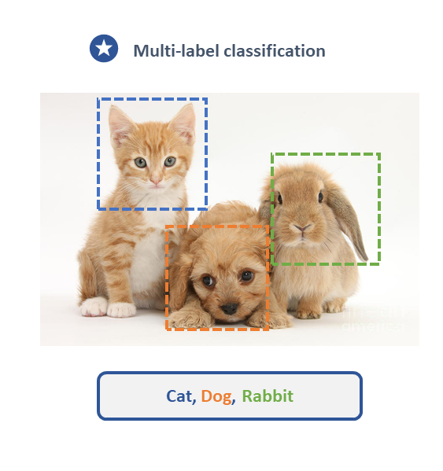
Image Classification
A form of machine learning used to distinguish features and patterns of different objects and categorize them into their corresponding labels.

Slide 4
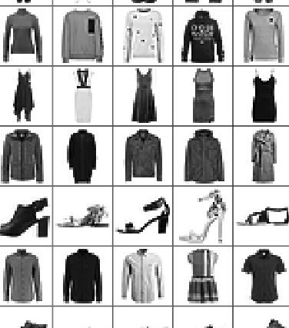
FashionMNIST

Slide 5
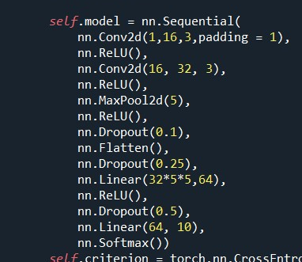
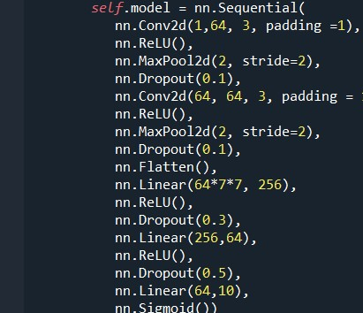
Online Code
Accuracy: ~73%
Batch Size: 10,000
Epochs: 80
Epoch Runtime:130-150s
My Code
Accuracy: ~63%
Batch Size: 10,000
Epochs: 300
Epoch Runtime: 20-40s

Slide 6
Online Code
Converted from TensorFlow to Pytorch.
Optimized for GPU over CPU
My Code
CrossEntropy Loss function
SGD Optimizer, lr=0.03
Uses Cyclic Learning Rate Scheduler

Slide 7
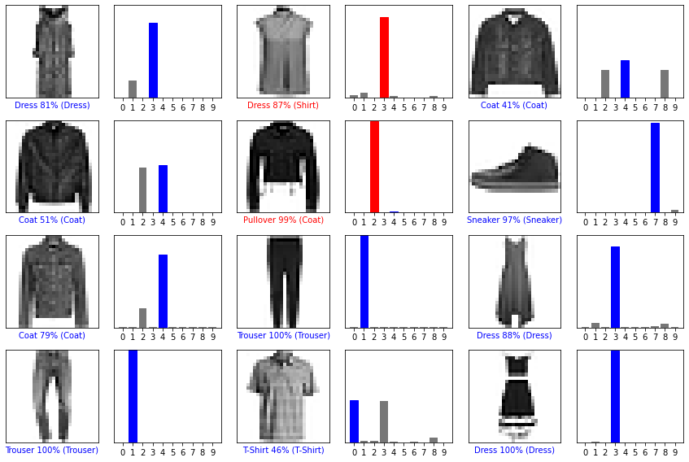
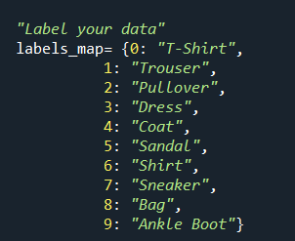
62% Accuracy

Slide 8
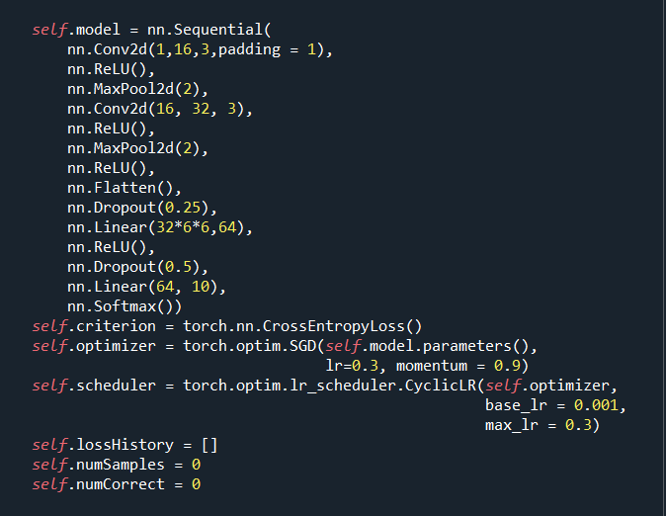
Updated Model
Added a second MaxPool2d
25 second run time per epoch
75% Accuracy

Slide 9
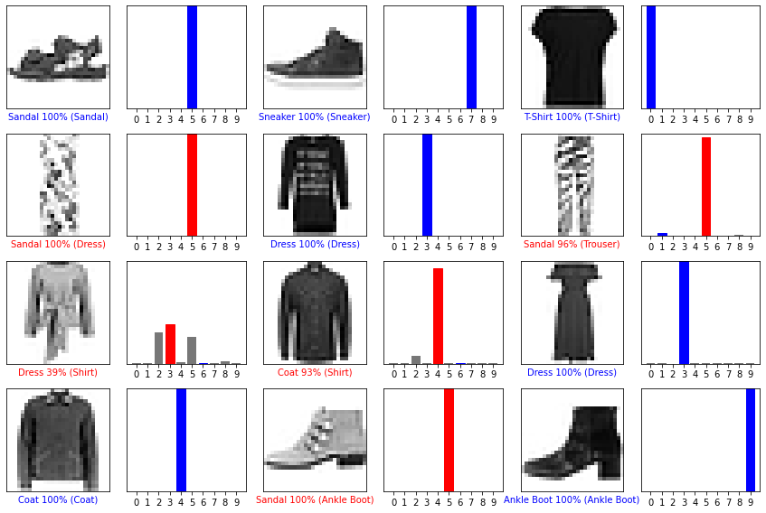
Updated Model with 75% Accuracy

Slide 10
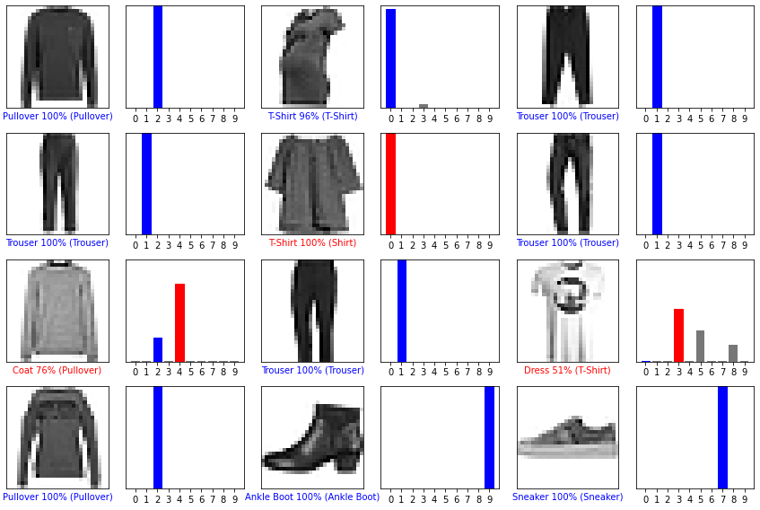
Updated Model with 75% Accuracy

Slide 11
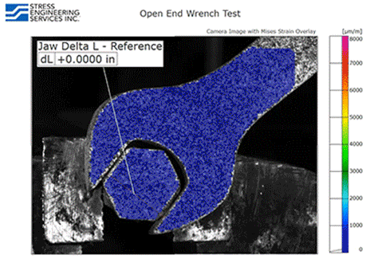
Digital Image Correlation

Slide 12
Digital Image Correlation
Non-contact means of measuring different properties
Usable for measuring parameters like strain, stress, and displacement
Cheaper and faster means of testing and simulating behaviors

Slide 13
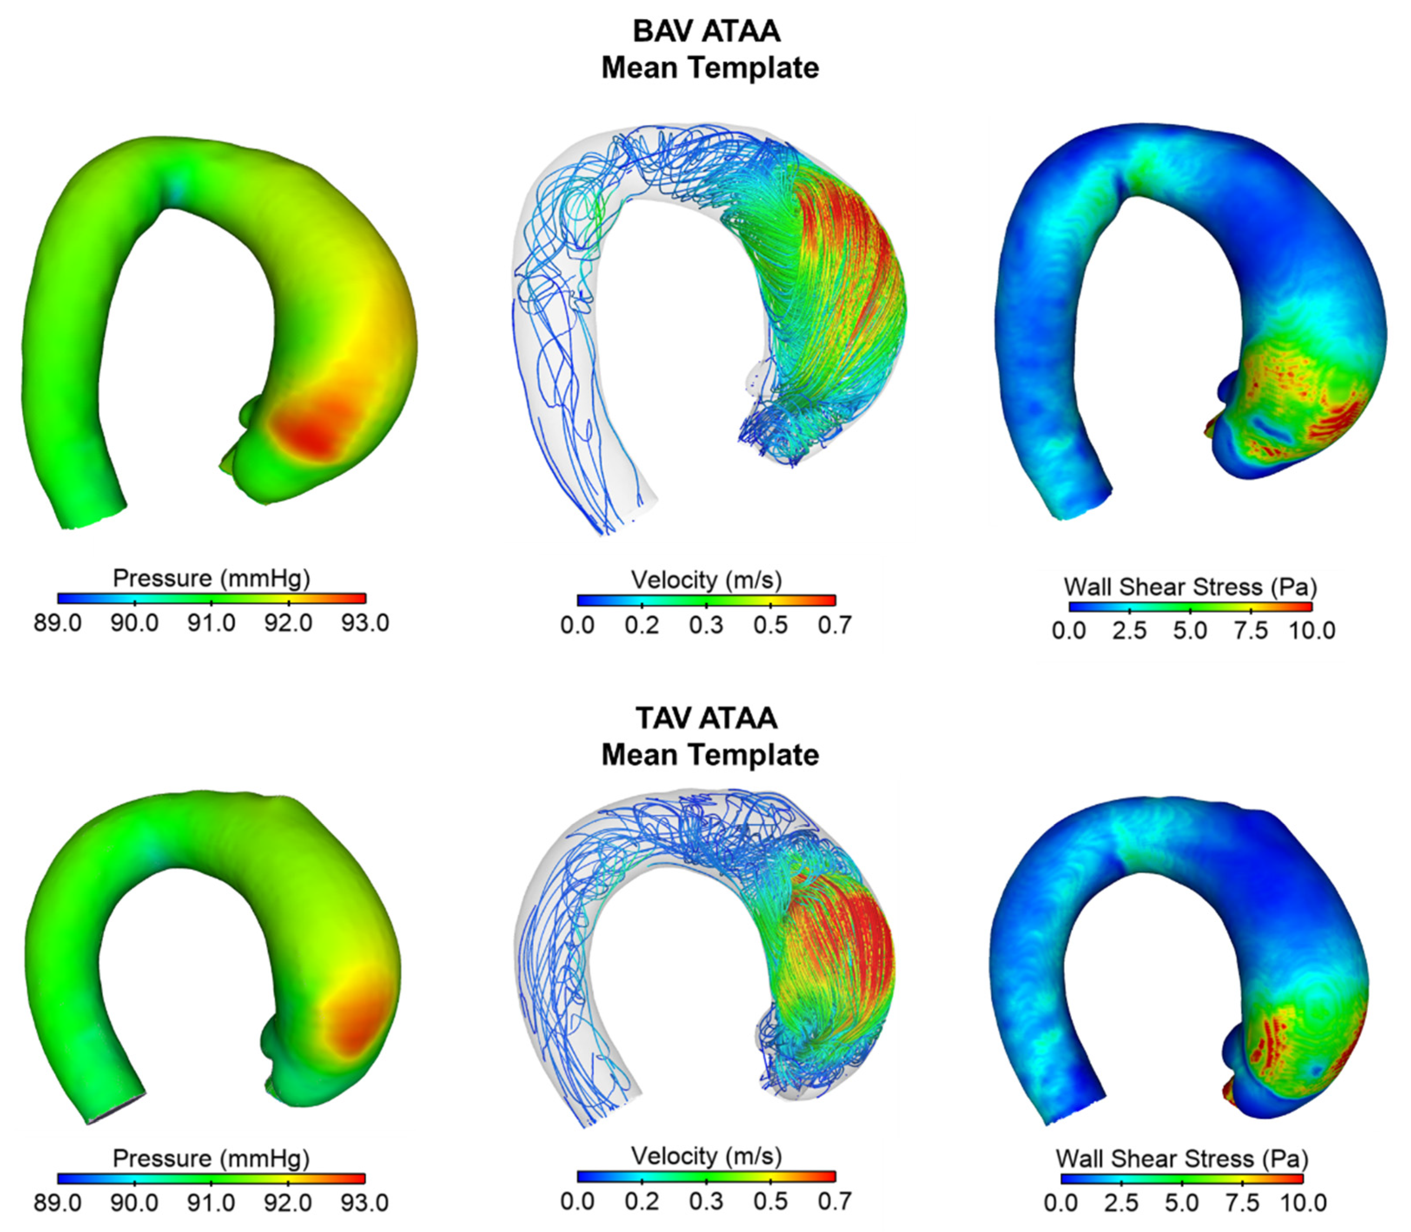
Aorta Code

Slide 14
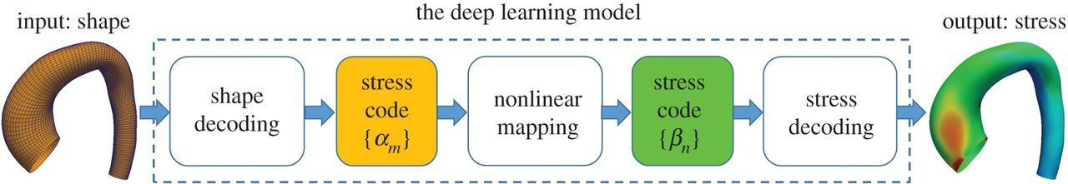
A deep learning approach to estimate stress distribution: A fast and accurate surrogate of finite-element analysis

Slide 15
